Slide 1
Design Evaluation

Slide 2
What is Design Evaluation ?
An evaluation design is a structure created to produce an unbiased appraisal of a program's benefits. The decision for an evaluation design depends on the evaluation questions and the standards of effectiveness, but also on the resources available and on the degree of precision needed.

Slide 3
The user interface evaluation cycle takes the form shown in Figure 11.5. After the design model has been completed, a first-level prototype is created. The prototype is evaluated by the user, who provides you with direct comments about the efficacy of the interface

Slide 4
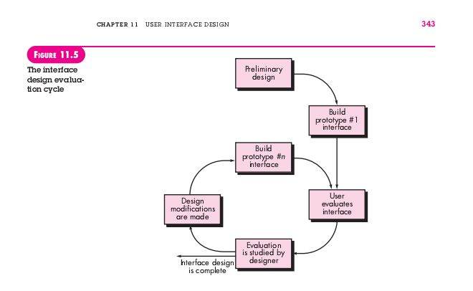

Slide 5
- If you identify and correct potential problems early, the number of loops through the evaluation cycle will be reduced and development time will shorten. If a design model of the interface

Slide 6
Evaluation Criteria can be applied during early design reviews: Interface style, help facilities, and error handling protocol provide a general indication of the complexity of the interface and the degree to which it will be accepted by the user.

Slide 7
MODELING
Users are observed during interaction, and data—such as number of tasks correctly completed over a standard time period, frequency of actions, sequence of actions, time spent “looking” at the display, number and types of errors, error recovery time, time spent using help, and number of help references per standard time period—are collected and used as a guide for interface modification.

Slide 8
Summary
(1) place the user in control, (2) reduce the user’s memory load, and (3) make the interface consistent. To achieve an interface that abides by these principles, an organized design process must be conducted.

Slide 9

THAT’S ALL !!! THANK YOU :)

